Slide 1
OAuth and Application Identity
Name
Title
Company

Slide 2
Agenda
SharePoint 2013 and Application Identity
Requesting and Granting Application Permissions
Authentication using OAuth
Authentication using Server-to-server (S2S) High Trust

Slide 3
SharePoint 2013 and Application Identity

Slide 4
Security Problems in SharePoint 2010
Code in farm solutions is considered to be fully-trusted
By default, code runs with permissions of current user
Developer can call SPSecurity.RunWithElevatedPrivledges
Allows code to run as all-powerful SHAREPOINT\System account
Allows code to revert to Windows identity of host application pool
Code in sandboxed solutions always runs as current user
Activation event code runs with permissions of activator (site administrator)
Activation event code can read/write any content in current site collection
Other code (e.g. Web Parts) runs with permissions of current user
No ability to elevate permissions if current user doesn't have what's required
Notes:
Code in a farm solution is considered to be fully-trusted. That means the code a developer writes in a farm solution runs with permissions of current user by default. However, a developer can call the method named SPSecurity.RunWithElevatedPrivledges which allows the code in a farm solution to run as all-powerful SHAREPOINT\System account. From the perspective of the Web server, the code reverts to Windows identity of host application pool which can be a powerful technique but it required a very high level of trust.
Code in sandboxed solutions always runs as current user. This means that the code in a feature activation event handler runs with permissions of the activator which is usually the site administrator or site collection owner. There, this code which runs during activation can read/write any content in current site collection. Other code such as the server-side code behind a Web Part runs with the permissions of the current user. There is no way for the developer to elevate permission or impersonate a different user.

Slide 5
How Do You Grant Permissions to Apps
What if you give the app a user login and password?
This allows app to authenticated and access content owned by user
App is able to complete its work by reading and modifying user's content
However...
Design based on giving user credentials to app has problems
Authorization system cannot distinguish app actions from user actions
App can do anything user can do (e.g. delete content, change password)
User must reset password to revoke permissions from an app-gone-bad
This approach must be rejected as basis for granting permissions to apps
Notes:
Think about the scenario where a user wants an app to access some content that is owned by that user. What would happen if you provide the app with user credentials such as a user login and password? This approach would allow the app to authenticated as the user and to access content owned by user. Therefore, the app is able to complete its work by reading and modifying user's content. However, this approach creates several problems.
Why does a security model based on providing an app with user credentials cause problems. First of all, the authorization system cannot distinguish the app or its actions from the user and his/her actions. Secord, the app can do anything the user can do such as delete content and change the user's password. Furthermore, if you were required to revoke permissions to an app after providing it with a user name and password, the only option would be to reset the password often creates quite a bit of administrator work. Therefore, this approach must be rejected as basis for granting permissions to apps.

Slide 6
Authentication (AuthN) and Authorization (AuthZ)
Authentication used to create identity for security principal
SharePoint 2010 only supports user authentication
SharePoint 2013 adds support to authenticate SharePoint apps
SharePoint apps are given first class identities
Authorization provides the infrastructure for access control
Used to verify an authenticated principal has the proper permission
SharePoint 2010 only supports configuring permissions for users and groups
SharePoint 2013 adds support to configure permissions for SharePoint apps
Notes:
The two most basic concepts in computer security are authentication (AuthN) and authorization (AuthZ). Authentication is a process which answers the basic question "who are you". Authorization answers the basic question, "what can you do".
Authentication used to create identity for security principal. SharePoint 2010 supports authenticating users. However, SharePoint 2013 adds support to authentication Apps in addition to users. This means that Apps in SharePoint 2013 are given first class identities.
SharePoint provides an authorization infrastructure which allows privileged users configure access control for other users and apps to access SharePoint sites and the elements inside such as pages and documents. SharePoint 2013 tracks user permissions using access control list (ACL) entries stored in the content database. SharePoint also tracks permissions for Apps but not in the same way that is does for user permissions.

Slide 7
Authentication in SharePoint 2013
Authentication Flow in SharePoint 2013
In calls to standard SharePoint sites, authentication essentially unchanged
In calls to app webs, call is internally authenticated with app identity
In remote calls, apps are authenticated using app-specific security tokens
Security token can contain both app and user identity or just app identities
Requirements for establishing SharePoint app identity
Host Web Application must be a claims-based Web Applications
Incoming calls must target CSOM/REST endpoints
Supported CSOM/REST endpoints not extensible in SharePoint 2013
Notes:
You should understand how authentication flow works in SharePoint 2013. In a regular site (one that is not an app web), user authentication is essentially unchanged from SharePoint 2010. However, calls to app webs are authenticated with both user identity and app identity. When an app is running remotely, the app passes a security token to the SharePoint Web server to establish its identity. When an app creates a security token to send to a SharePoint Web server, it usually also includes the identity of the current user. However, it is also possible for an app to create a security token that is app-only which means it does not contain information about a specific user.
Keep in mind that are a few requirements for authenticating SharePoint app identity. First, the hosting Web Application must be a claims-based Web Applications. Also, incoming calls must target CSOM/REST endpoints as you will see in the next slide. Note that the supported CSOM/REST endpoints cannot be extended with custom Web services in SharePoint 2013. You can only authenticate an app using CSOM/REST entry points that ship with SharePoint 2013.

Slide 8
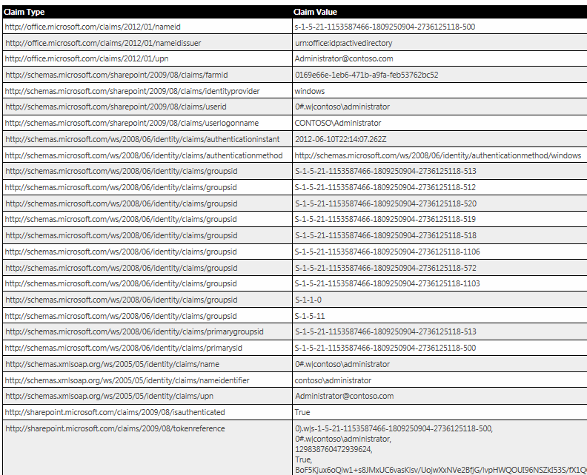
User Authentication, Claims and the SAML Token
Users Authenticate using Claims
User info carries in SAML token
SAML Token created by trusted STS
User
desktop computer
laptop computer
mobile device
iPad or other tablet
SharePoint Server
SharePoint 2013
Web Server
Notes:
In SharePoint 2013, it is highly recommended to configure all user authentication using claims-based security. With claims-based security, an identity provider authenticates users by inspecting user credentials such as a user logon name and a password. The identity provider creates and signs a security token using an XML-based language known as Security Assertion Markup language (SAML). The screenshot in the slide above shows an example of a SAML token created by local Security Token Service in an on-premise SharePoint farm.
In the most straightforward deployments in an on-premise scenario, a local farm runs a local Security Token Service (STS) which can be configured to create SAML tokens for users authenticating with Integrated Windows Authentication, Basic Authentication and Forms-based Authentication (FBA). A local SharePoint farm can also be configured to trust external identity providers which create SAML tokens such as Windows Live ID or an enterprise-wide STS creating with ADFS 2.0.
Starting with SharePoint 2013, Microsoft recommends against configuring Web Application with classic mode security. While SharePoint 2013 does still make configuring a Web application with classic mode security possible, you should understand this support is mainly provided for backwards compatibility. For this reason, Central Administration only makes it possible to create new Web application that support claims-based security. Now the only way to create classic-mode Web application is by using PowerShell cmdlets.

Slide 9
SharePoint 2013 Authentication Flow
Start
User credentials provided?
Yes
Is the endpoint outside of an app web?
Yes
Set user context
No
No
OAuth token present?
Yes
Is endpoint CSOM?
Yes
Does the token include user info?
Yes
Set app and user context
No
No
No
Set App-Only context
Use anonymous context
End
Notes:
When SharePoint 2013 begins to authenticate an incoming request, it first looks to see if the incoming request contains a SAML token with a user identity. If the SharePoint 2013 authentication pipeline finds a SAML token, it can then assume that the incoming request was initiated by a user and not an app. Once it finds a SAML token, SharePoint 2013 then inspects the target URL of the incoming request to see whether it references a standard SharePoint site or a child site associated with a specific app (i.e. an AppWeb). If the incoming request targets a standard site, SharePoint 2013 conducts its authentication and authorization identically to how things worked in SharePoint 2010. If the incoming request targets an AppWeb, SharePoint 2013 initializes the call context with both a user identity and an app identity.
When an incoming request does not contain a SAML token, SharePoint 2013 knows that a user did not initiate the request. In this scenario, the SharePoint 2013 authentication pipeline inspects the incoming to see if it contains a security token identifying a developer=hosted app. The security token for an app can be created using OAuth when Office 365 and ACS is involved. If the security token for an app was created in a server-to-server (S2S) configuration, it will be similar to but slightly different from a valid OAuth token. Once SharePoint 2013 finds a security token identifying an app, it sets up call context with the app identity and optionally the user identity as well.

Slide 10
Inspecting User Claims in the SAML Token
demo

Slide 11
Requesting and Granting Application Permissions

Slide 12
What is a SharePoint Tenancy?
A set of site collections
Configured and administrated as a unit
Tenancy has an administrative Site Collection with administrative UI
A scope for provisioning site collection for Office 365 customers
A scope for installing and configuring SharePoint apps
A scope for configuring permissions associated with developer-host apps
What About Tenancies in On-premise Farms?
By default, all site collections in a farm run within a default tenant
Additional tenancies can be created using PowerShell cmdlets
Notes:
A tenancy is set of site collections which have been configured for and made accessible to a set of tenants (i.e. users). The concept of tenancies was first introduced in SharePoint 2010 but has become more important with SharePoint 2013 and Office 365. When a company uses Office 365 to provision SharePoint sites for its users (e.g. employees), site collections and sites are created and managed in terms of one or more tenancies.
A tenancy is a set of site collections which are configured and administrated as a unit. Within a tenancy there is a special administrative site collection that allows a tenant administrator to configure various aspects of the tenancy. What's important for the purposes of this lecture is that a tenancy provides a scope for installing and configuring SharePoint apps. They also provide a scope for configuring permissions associated with developer-host apps.
The explicit use of tenancies is much more prevalent in Office 365 environments than it is with on-premise farms. However, every site collection still runs inside a specific tenancy. In an on-premise farm scenario in which tenancies are not being explicitly created, all site collections in the farm run within a default tenant. In scenarios where it makes sense, additional tenancies can be created and site collections can be added to them using PowerShell cmdlets.

Slide 13
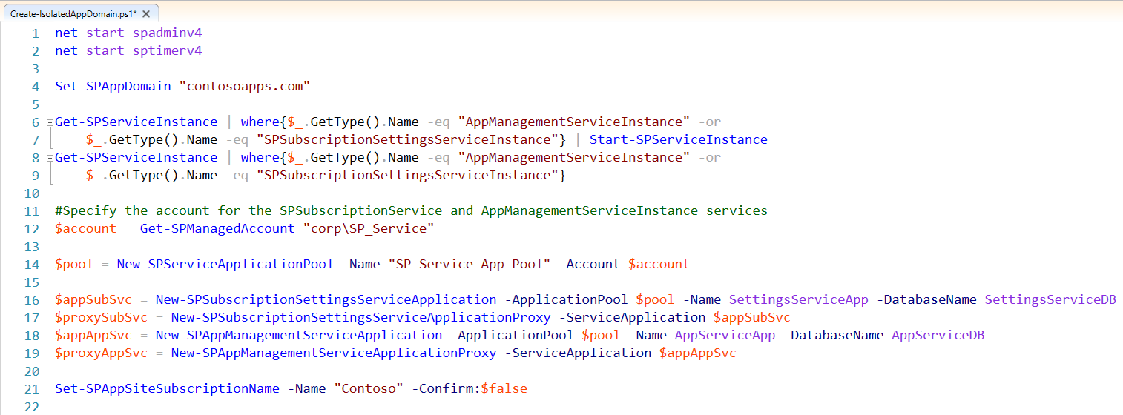
Configuring An On-premise Farm for Running Apps
Creating an isolated app domain
Notes:
Before you can run and test SharePoint apps on your local SharePoint farm, you must run a script named ConfigureApp.ps1. This script adds app support to the local farm's default tenancy by configuring a domain (e.g apps.Contoso.com) in which AppWebs are run. This script also ensures that various service application are already running such as the new Application Management Service and the Site Subscription Service which are required for running SharePoint apps.
When you run this script, you have the ability to provide a base DNS name for apps (e.g. apps.Contoso.com) as well as a new or existing Web application to run the AppWebs for apps.

Slide 14
App Permissions
App are granted permissions
App permissions are different from user permissions
App permissions are granted as all or nothing at a specific scope
Unlike user permissions, app permissions have no permissions hierarchy
An app has a default set of permissions
App has full control over app web but no default permissions to host web
App can request permission using declarative XML within application manifest
Installing user either grants or denies permissions during installation
If installer denies permission request, SharePoint does not install the app
Notes:
In SharePoint 2013, apps are granted permissions but the way that permissions work for apps is different from how permissions work for users. First of all, app permissions and user permissions are tracked separately. Secondly, permissions requested by an app are either granted or denied as an all or nothing proposition. It is not possible for a user to grant an app only a portion of the permissions it has requested. A user must either grant all permissions or deny all permissions.
If you have worked with SharePoint 2010, you might have an understanding that user permissions are configured in terms of a hierarchy of securable objects which include sites, lists and items. App permissions are different in that they do not involve a hierarchy of securable objects. Instead, app permissions are tracked as top-level permissions within the app installation scope which is either site-scoped or tenancy-scoped.
An app is given a default set of permissions after installation in which the app has full control over app web but no default permissions to access the host web. In app designs where the app must access the host web, the app manifest contains declarative XML which represents one or more permission requests. When a user installs an app, the user is prompted to either grant and deny these requested permissions. If the installing user grants permissions, the app is installed and SharePoint tracks that the app has these additional permissions. If the installing user denies the permission requests, SharePoint does not install the app.

Slide 15
Permission Requests
Apps request the permissions they require to run
<AppPermissionRequests AllowAppOnlyPolicy="true">
<AppPermissionRequest Scope="http://sharepoint/content/sitecollection" Right="Read"/>
<AppPermissionRequest Scope="http://sharepoint/content/sitecollection/web/list" Right="Write">
<Property Name="BaseTemplateId" Value="101"/>
</AppPermissionRequest>
<AppPermissionRequest Scope="http://sharepoint/userprofilestore/feed" Right="Post"/>
<AppPermissionRequest Scope="http://exchange/calendars" Right="Schedule"/>
<AppPermissionRequest Scope="http://lync/contacts" Right="Read"/>
</AppPermissionRequests>
Notes:
This slide shows an example of the XML required to add permission requests to an app manifest. Note that app permission requests can allow app-only policy which means that only the app and not the current user requires the needed permissions. If app-only policy is not used, then both the app and the current user require the necessary permissions to complete a task such as adding an item or creating a list. An important aspect of app-only policy is that it can elevate the permissions of the app so it can do more than the current user. It also makes it possible for an app to call in to SharePoint and access the app web or host web when there is no current user.

Slide 16
Permission Requests
App Permission Scope Defines
Product
Permission Provider
Target object - - where grant is requested
<AppPermissionRequest Scope="http://sharepoint/content/sitecollection" Right="Read" />
Product
Permission
Provider
Target
Object
Capability
Notes:
An app permission request contains a scope attribute an a Right attribute. The Scope attribute contains a string that contains the following pieces of information.
Product (e.g. - SharePoint versus Exchange versus Lync)
Permission Provider - Is the request for permissions to content or a specific service such as search, user profiles, etc
Target object - an object where grant is requested such as a tenancy, site collection, site or list
Scope for a tenancy:
http://sharepoint/content/tenant
Scope for a site collection
http://sharepoint/content/sitecollection
Scope for a Website
http://sharepoint/content/sitecollection/web
Scope for a list
http://sharepoint/content/sitecollection/web/list
The Right attribute defines the type of permission being requested. SharePoint Foundation standardizes four basic rights which are Read, Write, Manage and FullControl. Most permissions are configured in terms of these four rights. However, there are some permissions such as search permissions that use specialized permissions such as QueryAsUserIgnoreAppPrincipal.

Slide 17
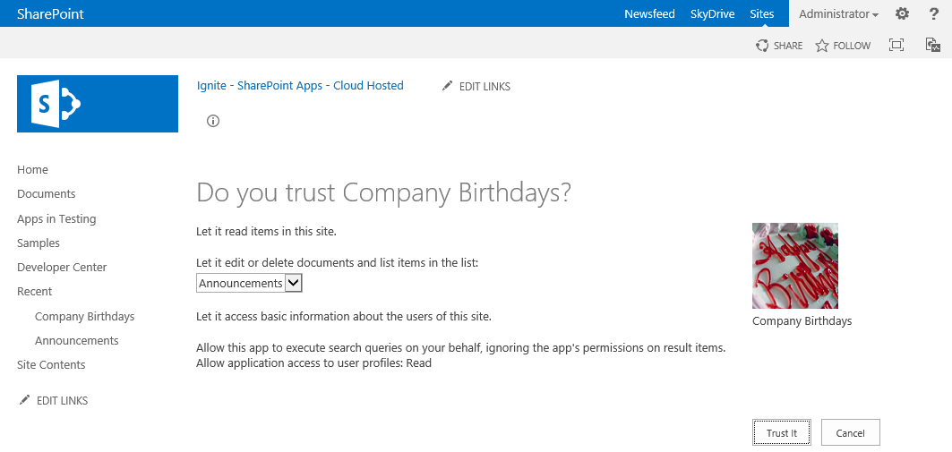
Granting Consent in SharePoint 2013
Installing User prompted to Deny or to Allow Access (grant)
Deny prevents app from being installed
Allow Access grants requested permissions to app as part of installation
Notes:
When a user installs an app that requests permissions beyond the standard default permissions, SharePoint 2013 shows the installing user which permissions have been requested and also prompts the installing user to select either Deny or Allow Access. . If the installing user grants permissions, the app is installed and SharePoint tracks that the app has these additional permissions. If the installing user denies the permission requests, SharePoint does not install the app. A key point here is that an app is never installed with a partial set of permissions. It either gets installed with the permissions it needs or it does not get installed.

Slide 18
Authentication using OAuth

Slide 19
OAuth 2.0 Primer
What is OAuth?
Internet protocol for creating and managing app identity
A cross-platform mechanism for authenticating and authorizing apps
An emerging Internet standard already used by Facebook, Google and Twitter
OAuth allows app identity to be recognized apart from user identity
App must be granted permissions independently of user permissions
By default, app is constrained in what it can do during and after installation
Apps can request installing user to grant specific types of permissions
App can be granted more permissions than current user has (i.e. elevation)
Notes:
OAuth is an Internet security protocol for authenticating apps and authorizing them to access content on behalf of a specific user. Microsoft selected OAuth for app authentication with SharePoint 2013 because it provides a cross-platform mechanism for authenticating and authorizing apps. It is also noteworthy that the OAuth protocol is an increasingly popular Internet standard which is already used by sites that support apps such as Facebook, Google and Twitter. Note that these sites and SharePoint 2013 use OAuth version 2.0 which is significantly different from OAuth version 1.0.
The OAuth protocol allows a SharePoint 2013 to authenticate a developer-hosted app which is calling to a SharePoint site from across the network and to establish an identity for the app in the calling context. This makes it possible for SharePoint to manage permissions and enforce access control for apps separately from users.
Note that the OAuth protocol has provisions to track app permissions in addition to app identity. However, SharePoint 2013 uses OAuth only to authenticate apps and establish app identity. SharePoint 2013 does not leverage to OAuth protocol in any way to track or pass permissions. Instead, SharePoint tracks all app permissions in its own internal databases.

Slide 20
OAuth Concepts and Terms
Content Owner(s)
User (or users) who can grant permissions to content in a site
Client App
This is the remote app that needs permissions to site content
Content Server
The Web server that runs the site with content to be accessed
Authentication Server
Trusted server that authenticates apps and creates OAuth tokens
Notes:
In whitepapers and technical articles which discuss OAuth, you will often see the 4 common terms which are shown on the slide above.
A content owner is a user that owns a resource (e.g. SharePoint site or a SharePoint list) or has the administrative rights to configure permissions on the resource. Note that with a SharePoint site, there is often more than one content owner such as the case where a site has two or more site administrators.
The client app is the developer-hosted app running across the network from the SharePoint farm. The client app is the entity that is recognized as a first class security principal that must be explicitly configured with permissions in order to access the host site.
The content server is the Web server which runs the site with content to be accessed. In SharePoint 2013 scenarios involving OAuth , the content server will be a Web server running within a SharePoint 2013 farm.
The authentication server is a trusted server that is used to help authenticate apps and to create OAuth tokens used to call from the client app to the content server. Note that with the SharePoint 2013 OAuth implementation, the authentication server will always be running the Windows Azure Access Control services (ACS).

Slide 21
Windows Azure Access Control Service (ACS)
ACS required with OAuth implementation in SharePoint 2013
ACS server acts as authentication server
ACS server must be trusted by content server
ACS server must be trusted by client app
How is the ACS server configured as the authentication server?
It's automatically configured for sites in Office 365 tenancy - nothing to do
In an on-premise farm, a trust to ACS must be configured with PowerShell
Notes:
Windows Azure Access Control Service (ACS) is a requirement for using the OAuth protocol with SharePoint 2013. The ACS server acts as authentication server. The SharePoint servers acting as the content servers must be configured to trust the ACS server. The client app must also be written to trust the ACS server as well.
When you are using sites in an Office 365 tenancy, there is no need to configure a trust to ACS. That's because Office 365 and each new tenancy are preconfigured with trusts to the ACS authentication server. However, the same configuration is not done automatically performed for on-premise farms. To leverage OAuth and ACS in an on-premise farm, you must configure the required trusts to ACS using PowerShell scripts.

Slide 22
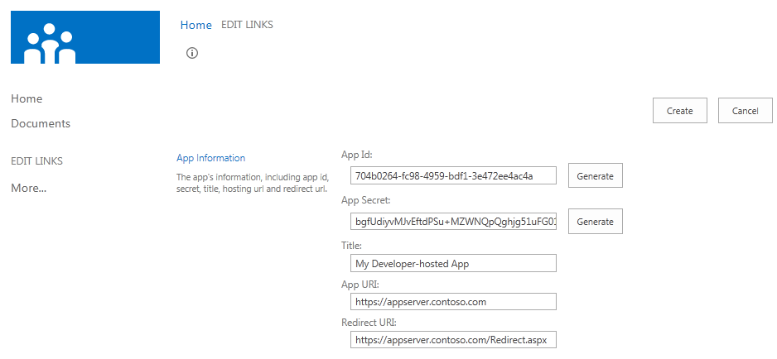
Registering a New App Principal
You need five pieces of information to register an app principal
App ID (aka client ID)
App Secret
Title
App URI
Redirect URL
SharePoint 2013 provides an application page for registering SharePoint apps
http://contososerver/_layouts/15/appregnew.aspx
Notes:
You need five pieces of information to register the app principal which will be used by a developer-hosted SharePoint app.
The App ID is an identifying GUID for the app. The App ID will be registered with SharePoint as well as with ACS. The App ID also must be copied into the app manifest of SharePoint app projects as well as the web.config file an ASP.NET Web Project which provides the server-side processing for a developer-hosted app. Note that the App ID is sometimes also referred to as the ID.
The App Secret a base64 encoded string which is used to encrypt and decrypt messages that are sent back and forth between ACS and the client app. The App Secret for an app principal is passed to ACS during registration. The App Secret is usually track by the client app by storing it in the web.config file.
The Title is the caption that appears for a registered app principal.
The App URI is the base URL used to access the developer-hosted app from across the network.
The Redirect URL is an optional setting that references a landing page that SharePoint can use to call back into the developer-hosted app when the developer-hosted app has made a specific type of request. For example, when a developer-hosted app has requests additional permissions using code, SharePoint will take direct the user to the standard application page which prompts the user to either Deny or Allow the permissions requested. Once the user clicks Deny or Allow Access, SharePoint will then redirect the user back to a page in the developer-hosted app which is referenced by the Redirect URL. When SharePoint calls back to the page referenced by the Redirect URL, it make an HTTP POST request and passes parameters which allow the developer to determine whether the requested permissions were denied o granted.
SharePoint provides an application page named appregnew.aspx which can be used by a user (or a developer) to register a new application principal. As you can see from the screenshot in the slide above, the appregnew.aspx page provides the option to automatically generate a new GUID for the App ID and a new base64-encoded string which can be used for the App Secret. You can then add a title for the app principal and an App URI which contains the URL at which the developer hosted app will be made accessible. You can also optionally add a Redirect URL if your app uses functionality that requires a call back page.

Slide 23
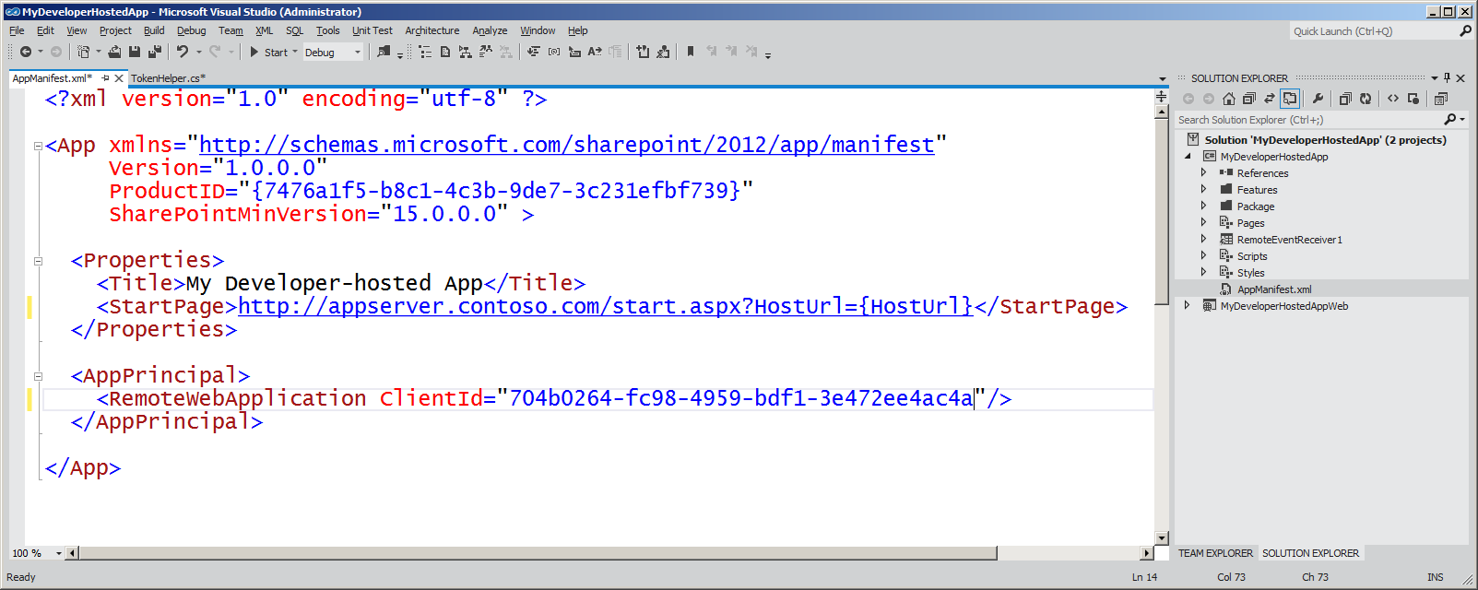
App Manifest for a Developer-hosted App
Notes:
When using OAuth with a developer-hosted app, the app manifest must include the App ID of a registered app principal in the ClientId attribute of the RemoteWebApplication element.

Slide 24
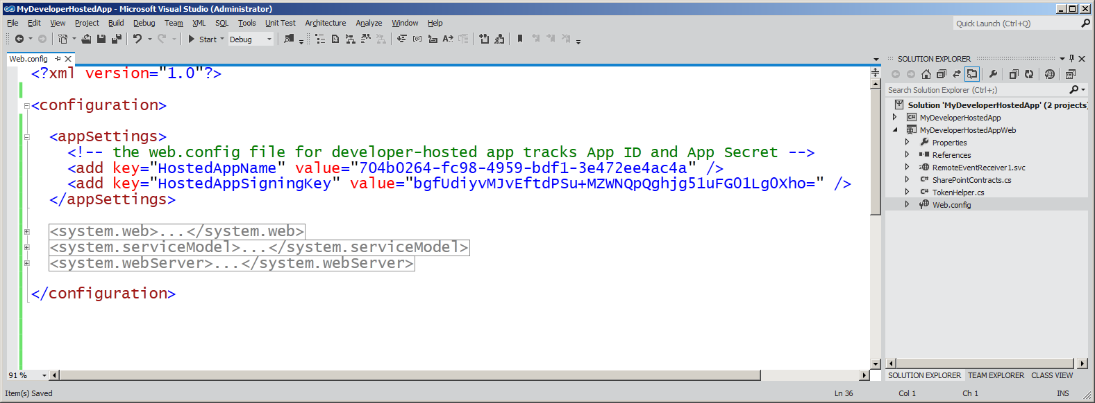
The web.config file of the App's Web Project
web.config file for developer-hosted app should track App ID and App Secret
These values are usually stored using appSettings with well-known setting names
Notes:
The server-side web project for a client app must have access to the App ID as well as the App Secret. The client app uses the App Secret to encrypt and decrypt messages sent back and forth it and ACS. These two values should be tracked using appSettings with well-known names. The App ID is tracked by a appSetting value named HostedAppName and the App Secret is tracked by a appSetting value named HostedAppSigningKey.

Slide 25
OAuth Protocol Flow in SharePoint 2013
1
SharePoint Authenticates user using claims
Content Server
SharePoint 2013
Web Server
2
SharePoint requests context token from user
1
2
3
SharePoint requests context token from user
4
SharePoint passes context token to user
User
desktop computer
laptop computer
mobile device
tablet or iPad
4
3
Authentication Server
Trusted ACS server that authenticates applications and creates OAuth tokens
5
9
User POSTS to app passing context token
8
6
Client App is able to pull refresh token out of the context toke. Client app then passes refresh token to ACS to request oAuth token
5
6
7
Client App
Web Server running remote app code
ACS returns OAuth token to client app
8
Client App makes CSOM/REST calls to SharePoint site passing OAuth token
10
7
9
SharePoint returns site content to app
10
Client App returns HTML to user device
Notes:
The slides shows a walkthrough of the typical authentication flow used by SharePoint 2013 when an app is authenticated using OAuth and calls into a SharePoint site.
User connects to the SharePoint site. SharePoint authenticates the user and creates a SAML token which contains information about the user identity.
SharePoint queries its Application Management database using the App ID and determines whether the app is external of not. If the app is external and has a registered app principal, SharePoint calls to ACS to create a context token passing information about the app and also about the current user.
ACS creates a context token which contains information about the app principal and about the user. The context token also contains a refresh token which is used by the client app. Also note that certain aspects of the context token are signed by ACS using the App Secret and can only be ready by the client app which also has a copy of the app secret.
SharePoint returns a page to the browser which contains a launcher (e.g. a clickable tile) allowing the user to redirect from the SharePoint site to the client app.
When the user clicks on the launcher, JavaScript behind the launcher issues an HTTP POST request to redirect the user to the client app. The body of this HTTP POST request contains the context token as named form parameter.
The client app reads the context token and exacts the refresh token from inside. The client app passes the refresh token to ACS in a request to create an OAuth token. Part of the message to ACS is signed with the App Secret.
ACS uses the App Secret to authenticate the client app request. If authentication succeeds, ACS creates and OAuth token and returns it back to the client app.
The client app uses the OAuth token to make CSOM calls and REST calls into SharePoint.
SharePoint Authenticates the client app and makes sure it has the proper permissions to ensure it is authorized to do whatever it is attempting to do. If the call is authenticated and authorized, SharePoint performs whatever work is requested by the CSOM and/or REST calls and returns any information requested back to the client app.
The client app returns a page back to the user which contains HTML generated from data returned by CSOM and REST calls into SharePoint.

Slide 26
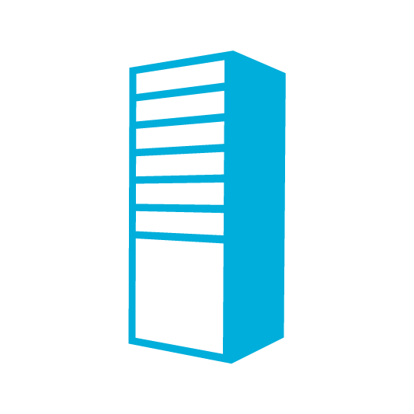







OAuth Flow
STS (ACS)
7- Access token
2. Request context token
3. Signed context token
6. Refresh token
8. Request – Access token
Client
1. Request
SharePoint Server
9. SharePoint data
4. Page - IFrame
5. Request IFrame contents
Intranet.contoso.com
10. IFrame contents

Slide 27
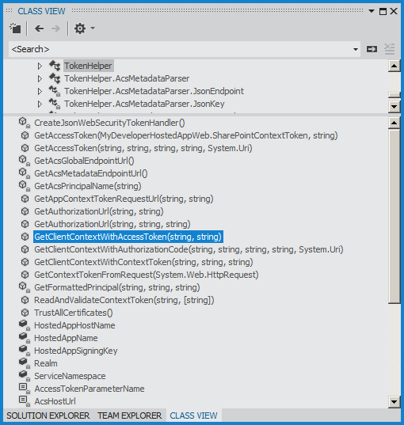
TokenHelper Class
Server-side app code is required to manage security tokens
Visual Studio provides TokenHelper class with public static methods
Notes:
When writing a client app, there is a need to provide code to deal with security issues such as reading the context token, extracting the refresh token and calling to ACS to create an OAuth token. When creating the Web Project for a SharePoint app in Visual Studio, you will see that Visual Studio automatically adds a helper class named TokenHelper. You can leverage this class to help assist with much of the security programming details.

Slide 28
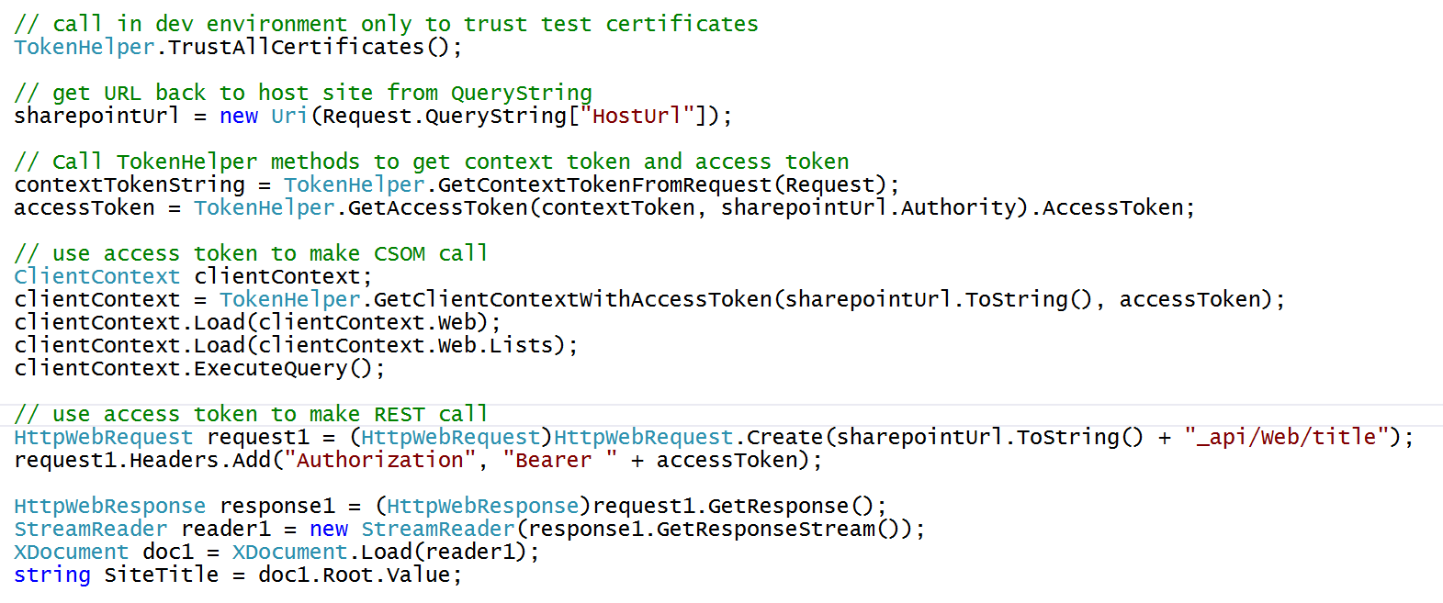
Using Access Token to make CSOM and REST Calls
Notes:
This code shows how to make CSOM and REST calls which are authenticated using an OAuth token. First, you should observe that the code discovers the URL back to the host site by reading a QueryString parameter named HostUrl.
In order to make authenticated CSOM calls, the client app calls the static GetClientContextWithAccessToken method of the TokenHelper class. This methods returns a new ClientContext object that has already been initialized in such as way that it sends the OAuth access token in a calls made to the SharePoint site.
In order to make authenticated REST calls, the client app calls the static GetAccessToken method of the TokenHelper class. This methods returns the access token as a string The access token should then be parsed together in a string that begins with "Bearer " and this string should be added to all REST calls using a header named Authorization.

Slide 29
Authentication using Server-to-server (S2S) High Trust

Slide 30
What is a Server-to-server (S2S) Trust
A trusted connection between client app and SharePoint Web server
Eliminates need to involve ACS when running apps within private networks
Trust between servers configured using one or more SSL certificates
App server code requires access to public/private key pair of SSL certificate
Requires creating S2S Security Token Service on SharePoint Web server(s)
Private Network Environment
SharePoint Web Server
S2S STS
1
User
3
4
2
Client App
SSL Cert
Public/Private key pair (.pfx)
Notes:
SharePoint 2013 makes it possible for Web servers in a SharePoint farm to a client app requests using a server-to-server (S2S) trust. This type of configuration can be used when deploying developer-hosted apps in a private network when it is beneficial to avoid any dependencies on ACS or any other servers running across the Internet. That means that all the servers involved can run behind a single firewall and on the same local area network.
A S2S trust represents a trusted connection between a client app running on a local app server and the Web servers in the SharePoint farm. Configuring the trust requires an SSL certificate which is based on the URL with the DNS name (e.g https://appserver.Contoso.com) where the client app is located. The client app contains code which has access to the private key associated with the SSL certificate and it uses this private key to sign security tokens. On the SharePoint Web Server, you must create a security token service which can use the public key to authenticate and decrypt these security tokens generated by the client app.

Slide 31
Adding S2S Support to Developer-Hosted Apps
What are the developer responsibilities with an S2S app?
Expose an endpoint to SharePoint to discover service metadata
Authenticate the user (can use Windows Authentication, FBA, etc.)
Create security tokens to send to SharePoint server
Details of creating the S2S security token
Security token is like OAuth token but differs from OAuth specification
Security token must contain app identity
Security token can optionally include user identity
Security token must be signed using private key of the SSL certificate
Notes:
There are several responsibilities for the developer when creating an S2S app. First, you must deploy the Web project that contains the implementation of the client app itself. Next, the client app must be configured to perform its own user authentication. This can be done using any supported style of authentication including Windows Integrated Authentication, Basic Authentication, FBA, etc. Finally, the client app must create its own security tokens and sign them with the private key associated with the SSL certificate.
Create security tokens to send to SharePoint server
Note that the security token created by a client app in the S2S trust scenario is like OAuth token but it differs from the OAuth specification in a few different ways. The security token created by a client app in an S2S trust must contain information about app identity. The security token created by a client app in an S2S trust usually contains information about the identity of the current user but this is not a requirement. Once the security token it created with the required information inside, it then must be signed with the private key before it is sent to the SharePoint server. This private key signing is what allows the SharePoint server to perform the authentication on calls originating from the client app.

Slide 32
Working with SSL Certificates
SSL Certificates
Binds together an identity and a public key
In production, use certificate issued by authority
In development, use self-signed certificates – trusted on local machine
Types of SSL certificate files
.cer file – an X509 certificate
.pvk file – the certificate's private key
.pfx file – the certificate's private key encrypted using a password
Notes:
Configuring an S@S trust requires the use of SSL Certificates. The purpose of an SSL certificate is often to bind together an identity (e.g. the client app) and a public key. SSL certificates used in production environments must be acquired from issuing authority such as VeriSign or GoDaddy.com. However, for development and testing, it is common to create self-signed certificates which can be configured to be trusted on the local machine for testing purposes.
An SSL certificate contains both a public key and a private key. The main idea is that only a trusted party has access to the private key where everyone has access to the public key.
.cer file – an X509 certificate
.pvk file – the certificate's private key
.pfx file – the certificate's private key encrypted using a password

Slide 33
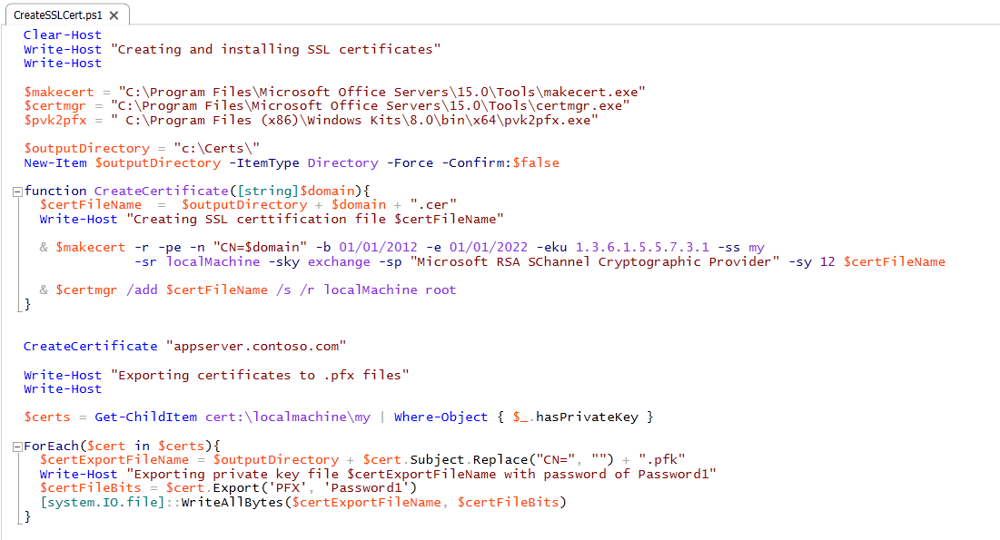
Creating Certificates
Notes:
This is an example of a PowerShell script that creates a self-signed SSL certificate for an app running at the DNS name of http://appserver.contoso.com. The self-signed certificate is made by calling the makecert.exe utility. Note that the script creates the self-signed certificate with a private key. This certificate is then installed into the certificate store on the local machine using the certmgr.exe utility. The code at the bottom of the script shows how to enumerate through the SSL certificates stored on the local machine and to find those that have private keys. The call to Export is what produces a private key file that is signed with the password of Password1.

Slide 34
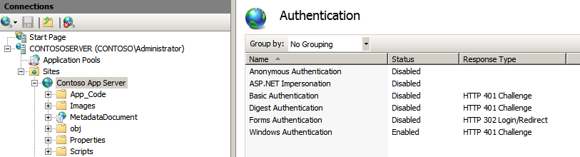
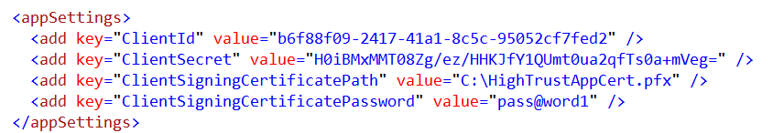
Creating an IIS Web Site for the App
Create an IIS Web Site to deploy developer-hosted app
Disable anonymous access to ensure all access is authenticated
Modify web.config file to add location to private key file and password
Notes:
The app is responsible for authenticating users. Therefore, you should disable anonymous access to the pages in the Web project for the app.
In order to properly configure the S2S trust, you must provide the Web project for the app with the file path to the signed private key file and the password to retrieve the private key. The app uses the private key to sign messages it send to the SharePoint Web servers in the target farm. Note that the app still needs the App ID tracked in the HostedAppName app setting but unlike an OAuth configuration, the App does not need an app secret because it uses the private key for signing messages instead.

Slide 35
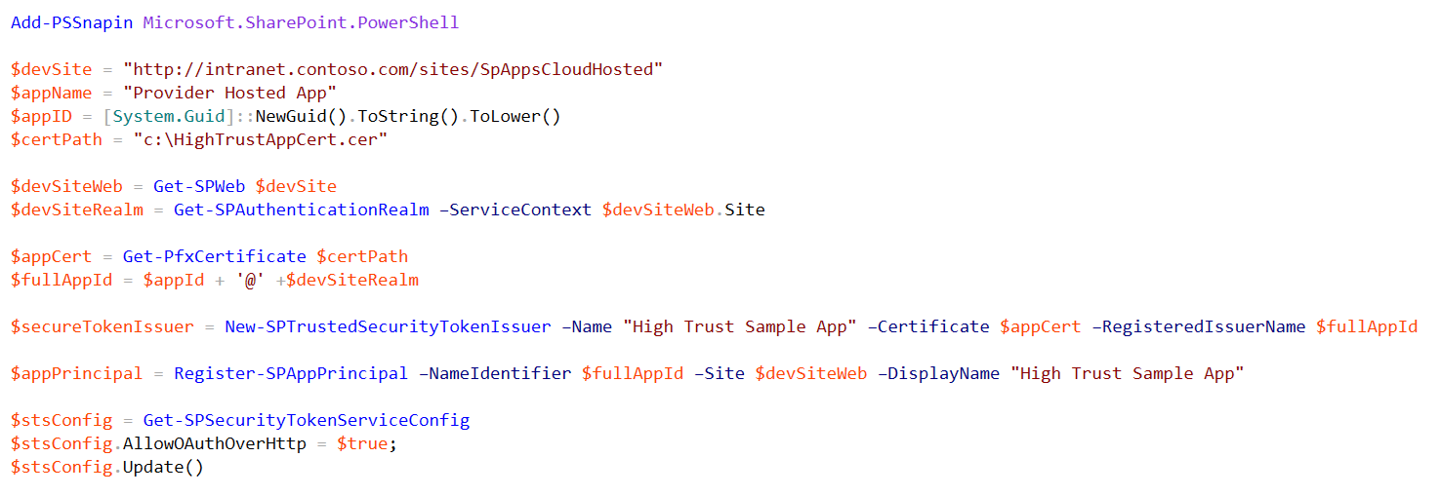
Registering an App Principal for an S2S App
App Principal registered using Register-SPAppPrincipal
Each registration scoped to a particular tenancy (i.e. realm)
Notes:
After creating the S2S trust between the client app and the SHarePoint Web servers, it is then required to register one on more app principals using the Register-SPAppPrincipal cmdlet. Note that app principals are scoped to a tenancy. If all the sites in the on-premise local farm are running within the default tenancy, you can create a single farm-wide app principal.
Once you have create the app principal, you can then assign permissions to it using the Set-SPAppPrincipalPermission cmdlet.

Slide 36
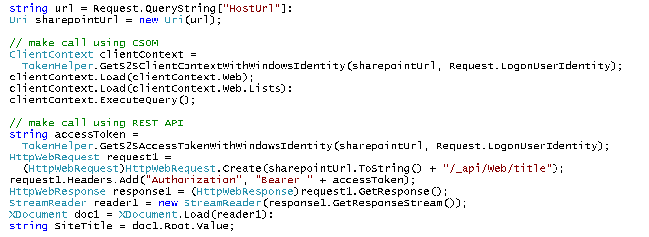
Making CSOM and REST Calls from a S2S App
TokenHelper class provides method explicitly for S2S Apps
GetS2SClientContextWithWindowsIdentity for making CSOM calls
GetS2SAccessTokenWithWindowsIdentity for making REST calls
Notes:
Once the S2S high trust configuration has been created and you have registered an app principal, you should then be able to make authenticated calls from the client app to the host web within the local SharePoint farm. This slides demonstrates using two methods in the TokenHelper class named GetS2SClientContextWithWindowsIdentity and GetS2SAccessTokenWithWindowsIdentity.
The GetS2SClientContextWithWindowsIdentity method can be used to set up security for CSOM calls while the GetS2SAccessTokenWithWindowsIdentity method makes it possible to set up security for making REST calls.

Slide 37
Summary
SharePoint 2013 and Application Identity
Requesting and Granting Application Permissions
Authentication using OAuth
Authentication using Server-to-server (S2S) High Trust

Slide 38

© 2012 Microsoft Corporation. All rights reserved. Microsoft, Windows, Windows Vista and other product names are or may be registered trademarks and/or trademarks in the U.S. and/or other countries.
The information herein is for informational purposes only and represents the current view of Microsoft Corporation as of the date of this presentation. Because Microsoft must respond to changing market conditions, it should not be interpreted to be a commitment on the part of Microsoft, and Microsoft cannot guarantee the accuracy of any information provided after the date of this presentation. MICROSOFT MAKES NO WARRANTIES, EXPRESS, IMPLIED OR STATUTORY, AS TO THE INFORMATION IN THIS PRESENTATION.

